Slide 1

Minimal Spanning Tree Basic Terminology, Applications and Algorithms

Slide 2
Overview
Introduction
What is Minimal Spanning Tree (MST)
Applications
Where we can use MST
Functions
How to find MST
Prim’s algorithm
Kruskal’s algorithm
Conclusions
Slide 2

Slide 3
Introduction
A Spanning Tree (ST) of a graph is a subgraph that contains all the vertices and is a tree, i.e., no Cycle & Connected.
A graph may have many spanning trees.
16 ST
Slide 3

Slide 4
Introduction Cont …
A Spanning Tree (ST) of a graph is a subgraph that contains all the vertices and is a tree, i.e., no Cycle & Connected.
A graph may have many spanning trees.
Let, the edges were weighted.
Minimal Spanning Tree (MST) is spanning tree with the minimum sum of edges,
Slide 4

Slide 5
Applications of MST
Phone network design.
The phone company charges different amounts of money to connect different pairs of cities.
Regional office
Central office
Regional office
Expensive
Slide 5

Slide 6
Applications of MST Cont …
Phone network design.
The phone company charges different amounts of money to connect different pairs of cities.
Regional office
Central office
Regional office
Better Approach
Slide 6

Slide 7
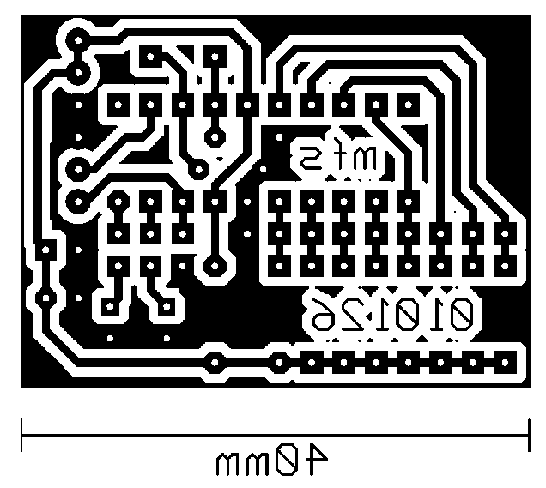
Applications of MST Cont …
Electronic circuitry
Set of pins wiring them together.
We want to minimize the total length of the wires.
Minimum Spanning Trees can be used to model this problem.
Slide 7

Slide 8
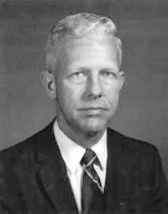
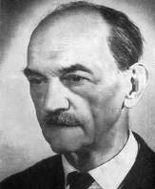
How We Can Find a MST
Greedy
Two Most Popular Algorithms
Prime’s Algorithm
Kruskal’s Algorithm
Robert Clay Prim is an American mathematician and computer scientist.
During the climax of World War II (1941–1944), Prim worked as an engineer for General Electric. From 1944 until 1949, he was hired by the United States Naval Ordnance Lab as an engineer and later a mathematician. At Bell Laboratories, he served as director of mathematics research from 1958 to 1961. There, Prim implemented the Prim's algorithm.
Which is was originally discovered in 1930 by mathematician Vojtech Jarnik and later rediscovered by Edsger Dijkstra in 1959.
Vojtěch Jarník was a Czech mathematician.
His main area of work was in number theory and mathematical analysis; he proved a number of results on lattice point problems. He also developed the graph theory algorithm which is now known as Prim's algorithm.
Slide 8

Slide 9
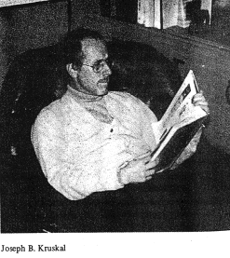
How We Can Find a MST Cont …
Greedy
Two Most Popular Algorithms
Prime’s Algorithm
Kruskal’s Algorithm
Joseph Bernard Kruskal, Jr. is an American mathematician.
His best known work is Kruskal's algorithm for computing the minimal spanning tree. The algorithm first orders the edges by weight and then proceeds through the ordered list adding an edge to the partial MST provided that adding the new edge does not create a cycle.
Kruskal also applied his work in linguistics, in an experimental lexicostatistical study of Indo-European languages, together with the linguists Isidore Dyen and Paul Black.
Slide 9

Slide 10
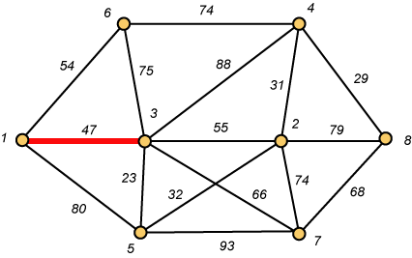
Prime’s Algorithm
Vertex based algorithm
Grows one tree T, one vertex at a time
Tree-vertices: in the tree constructed so far
Non-tree vertices: rest of vertices
Prim’s Selection rule “Select the minimum weight edge between a tree-node and a non-tree node and add to the tree.”
Select a vertex to be a tree-node
while (there are non-tree vertices) {
if there is no edge connecting a tree node with a non-tree node
return “no spanning tree”
select an edge of minimum weight between a tree node and a non-tree node
add the selected edge and its new vertex to the tree
}
return tree
Slide 10

Slide 11
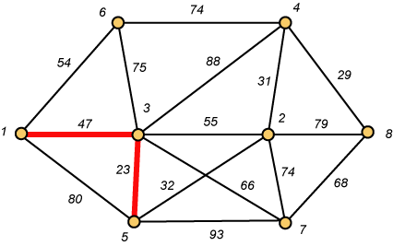
Prime’s Algorithm Cont …
Vertex based algorithm
Grows one tree T, one vertex at a time
Tree-vertices: in the tree constructed so far
Non-tree vertices: rest of vertices
Prim’s Selection rule “Select the minimum weight edge between a tree-node and a non-tree node and add to the tree.”
Slide 11

Slide 12
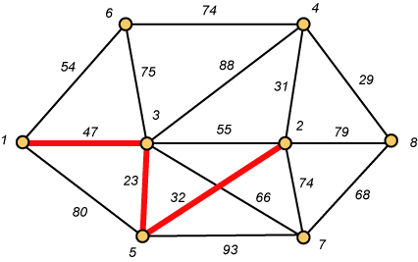
Prime’s Algorithm Cont …
Vertex based algorithm
Grows one tree T, one vertex at a time
Tree-vertices: in the tree constructed so far
Non-tree vertices: rest of vertices
Prim’s Selection rule “Select the minimum weight edge between a tree-node and a non-tree node and add to the tree.”
Slide 12

Slide 13
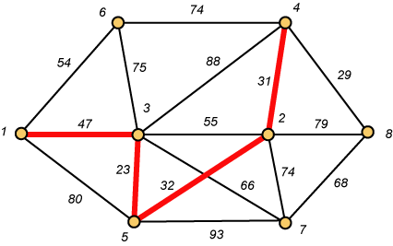
Prime’s Algorithm Cont …
Vertex based algorithm
Grows one tree T, one vertex at a time
Tree-vertices: in the tree constructed so far
Non-tree vertices: rest of vertices
Prim’s Selection rule “Select the minimum weight edge between a tree-node and a non-tree node and add to the tree.”
Slide 13

Slide 14
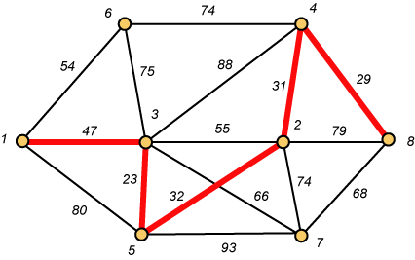
Prime’s Algorithm Cont …
Vertex based algorithm
Grows one tree T, one vertex at a time
Tree-vertices: in the tree constructed so far
Non-tree vertices: rest of vertices
Prim’s Selection rule “Select the minimum weight edge between a tree-node and a non-tree node and add to the tree.”
Slide 14

Slide 15
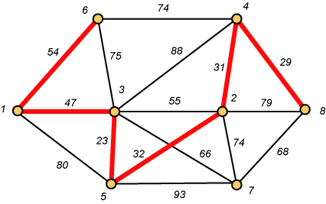
Prime’s Algorithm Cont …
Vertex based algorithm
Grows one tree T, one vertex at a time
Tree-vertices: in the tree constructed so far
Non-tree vertices: rest of vertices
Prim’s Selection rule “Select the minimum weight edge between a tree-node and a non-tree node and add to the tree.”
Slide 15

Slide 16
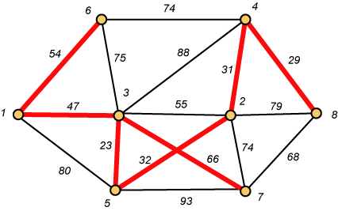
Prime’s Algorithm Cont …
Vertex based algorithm
Grows one tree T, one vertex at a time
Tree-vertices: in the tree constructed so far
Non-tree vertices: rest of vertices
Prim’s Selection rule “Select the minimum weight edge between a tree-node and a non-tree node and add to the tree.”
Weight of the Spanning Tree
=23+29+31+32+47+54+66
=282
Slide 16

Slide 17
Prime’s Algorithm Cont …
More Detail
r : Grow the minimum spanning tree from the root vertex “r”.
Q : is a priority queue, holding all vertices that are not in the tree now.
key[v] : is the minimum weight of any edge connecting v to a vertex in the tree.
π [v] : names the parent of v in the tree.
T[v] – Vertex v is already included in MST if T[v]==1, otherwise, it is not included yet.
Slide 17

Slide 18
Prime’s Algorithm Cont …
8
7
b
c
d
9
root
4
2
a
11
i
14
e
4
7
6
8
10
h
g
f
1
2
V | a | b | c | d | e | f | g | h | i
T | 1 | 0 | 0 | 0 | 0 | 0 | 0 | 0 | 0
Key | 0 | - | - | - | - | - | - | - | -
π | -1 | - | - | - | - | - | - | - | -
Slide 18

Slide 19
Prime’s Algorithm Cont …
8
7
b
c
d
9
root
4
2
a
11
i
14
e
4
7
6
8
10
h
g
f
1
2
V | a | b | c | d | e | f | g | h | i
T | 1 | 0 | 0 | 0 | 0 | 0 | 0 | 0 | 0
Key | 0 | 4 | - | - | - | - | - | 8 | -
π | -1 | a | - | - | - | - | - | a | -
Slide 19

Slide 20
Prime’s Algorithm Cont …
8
7
b
c
d
9
root
4
2
a
11
i
14
e
4
7
6
8
10
h
g
f
1
2
Important: Update Key[v] only if T[v]==0
V | a | b | c | d | e | f | g | h | i
T | 1 | 1 | 0 | 0 | 0 | 0 | 0 | 0 | 0
Key | 0 | 4 | 8 | - | - | - | - | 8 | -
π | -1 | a | b | - | - | - | - | a | -
Slide 20

Slide 21
Prime’s Algorithm Cont …
8
7
b
c
d
9
root
4
2
a
11
i
14
e
4
7
6
8
10
h
g
f
1
2
V | a | b | c | d | e | f | g | h | i
T | 1 | 1 | 1 | 0 | 0 | 0 | 0 | 0 | 0
Key | 0 | 4 | 8 | 7 | - | 4 | - | 8 | 2
π | -1 | a | b | c | - | c | - | a | c
Slide 21

Slide 22
Prime’s Algorithm Cont …
8
7
b
c
d
9
root
4
2
a
11
i
14
e
4
7
6
8
10
h
g
f
1
2
V | a | b | c | d | e | f | g | h | i
T | 1 | 1 | 1 | 0 | 0 | 0 | 0 | 0 | 1
Key | 0 | 4 | 8 | 7 | - | 4 | 6 | 7 | 2
π | -1 | a | b | c | - | c | i | i | c
Slide 22

Slide 23
Prime’s Algorithm Cont …
8
7
b
c
d
9
root
4
2
a
11
i
14
e
4
7
6
8
10
h
g
f
1
2
V | a | b | c | d | e | f | g | h | i
T | 1 | 1 | 1 | 0 | 0 | 1 | 0 | 0 | 1
Key | 0 | 4 | 8 | 7 | 10 | 4 | 2 | 7 | 2
π | -1 | a | b | c | f | c | f | i | c
Slide 23

Slide 24
Prime’s Algorithm Cont …
8
7
b
c
d
9
root
4
2
a
11
i
14
e
4
7
6
8
10
h
g
f
1
2
V | a | b | c | d | e | f | g | h | i
T | 1 | 1 | 1 | 0 | 0 | 1 | 1 | 0 | 1
Key | 0 | 4 | 8 | 7 | 10 | 4 | 2 | 1 | 2
π | -1 | a | b | c | f | c | f | g | c
Slide 24

Slide 25
Prime’s Algorithm Cont …
8
7
b
c
d
9
root
4
2
a
11
i
14
e
4
7
6
8
10
h
g
f
1
2
V | a | b | c | d | e | f | g | h | i
T | 1 | 1 | 1 | 0 | 0 | 1 | 1 | 1 | 1
Key | 0 | 4 | 8 | 7 | 10 | 4 | 2 | 1 | 2
π | -1 | a | b | c | f | c | f | g | c
Slide 25

Slide 26
Prime’s Algorithm Cont …
8
7
b
c
d
9
root
4
2
a
11
i
14
e
4
7
6
8
10
h
g
f
1
2
V | a | b | c | d | e | f | g | h | i
T | 1 | 1 | 1 | 1 | 0 | 1 | 1 | 1 | 1
Key | 0 | 4 | 8 | 7 | 9 | 4 | 2 | 1 | 2
π | -1 | a | b | c | d | c | f | g | c
Slide 26

Slide 27
Prime’s Algorithm Cont …
8
7
b
c
d
9
root
4
2
a
11
i
14
e
4
7
6
8
10
h
g
f
1
2
All T[v] = 1
So Done
V | a | b | c | d | e | f | g | h | i
T | 1 | 1 | 1 | 1 | 1 | 1 | 1 | 1 | 1
Key | 0 | 4 | 8 | 7 | 9 | 4 | 2 | 1 | 2
π | -1 | a | b | c | d | c | f | g | c
Slide 27

Slide 28
Kruskal’s Algorithm
Basic Terminology
Cut : Partition of V. Ex: (S, V-S)
Cross : Edge (u,v) crosses the cut (S, V-S) if one of its endpoints is in S and the other is in V-S.
Light edge : An edge crossing a cut if its weight is the minimum of any edge crossing the cut.
Kruskal’s Algorithm
Edge based algorithm
Add the edges one at a time, in increasing weight order
It maintains a forest of trees.
An edge is accepted it if connects vertices of distinct trees
Slide 28

Slide 29
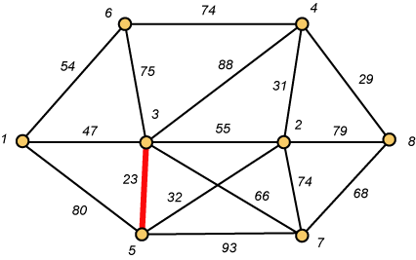
Kruskal’s Algorithm Cont …
Basic Terminology
Cut : Partition of V. Ex: (S, V-S)
Cross : Edge (u,v) crosses the cut (S, V-S) if one of its endpoints is in S and the other is in V-S.
Light edge : An edge crossing a cut if its weight is the minimum of any edge crossing the cut.
Kruskal’s Algorithm
Slide 29

Slide 30
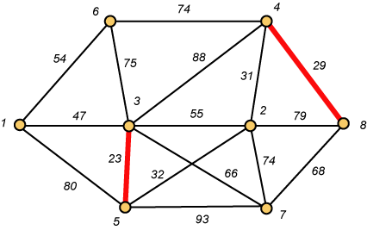
Kruskal’s Algorithm Cont …
Basic Terminology
Cut : Partition of V. Ex: (S, V-S)
Cross : Edge (u,v) crosses the cut (S, V-S) if one of its endpoints is in S and the other is in V-S.
Light edge : An edge crossing a cut if its weight is the minimum of any edge crossing the cut.
Kruskal’s Algorithm
Slide 30

Slide 31
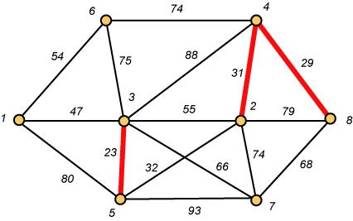
Kruskal’s Algorithm Cont …
Basic Terminology
Cut : Partition of V. Ex: (S, V-S)
Cross : Edge (u,v) crosses the cut (S, V-S) if one of its endpoints is in S and the other is in V-S.
Light edge : An edge crossing a cut if its weight is the minimum of any edge crossing the cut.
Kruskal’s Algorithm
Slide 31

Slide 32
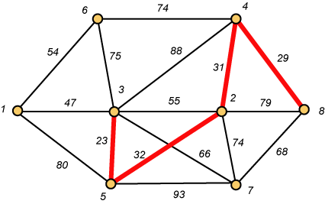
Kruskal’s Algorithm Cont …
Basic Terminology
Cut : Partition of V. Ex: (S, V-S)
Cross : Edge (u,v) crosses the cut (S, V-S) if one of its endpoints is in S and the other is in V-S.
Light edge : An edge crossing a cut if its weight is the minimum of any edge crossing the cut.
Kruskal’s Algorithm
Slide 32

Slide 33

Kruskal’s Algorithm Cont …
Basic Terminology
Cut : Partition of V. Ex: (S, V-S)
Cross : Edge (u,v) crosses the cut (S, V-S) if one of its endpoints is in S and the other is in V-S.
Light edge : An edge crossing a cut if its weight is the minimum of any edge crossing the cut.
Kruskal’s Algorithm
Slide 33

Slide 34
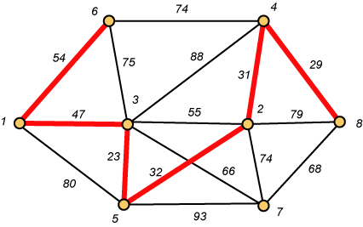
Kruskal’s Algorithm Cont …
Basic Terminology
Cut : Partition of V. Ex: (S, V-S)
Cross : Edge (u,v) crosses the cut (S, V-S) if one of its endpoints is in S and the other is in V-S.
Light edge : An edge crossing a cut if its weight is the minimum of any edge crossing the cut.
Kruskal’s Algorithm
Slide 34

Slide 35
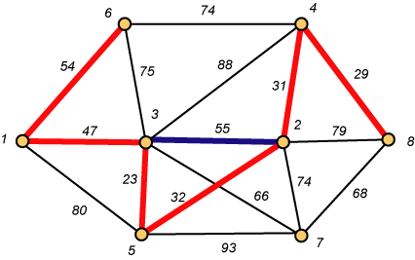
Kruskal’s Algorithm Cont …
Basic Terminology
Cut : Partition of V. Ex: (S, V-S)
Cross : Edge (u,v) crosses the cut (S, V-S) if one of its endpoints is in S and the other is in V-S.
Light edge : An edge crossing a cut if its weight is the minimum of any edge crossing the cut.
Kruskal’s Algorithm
Up to this point, we have simply taken the edges in order of their weight. But now we will have to reject an edge since it forms a cycle when added to those already chosen.
Slide 35

Slide 36
Kruskal’s Algorithm Cont …
Basic Terminology
Cut : Partition of V. Ex: (S, V-S)
Cross : Edge (u,v) crosses the cut (S, V-S) if one of its endpoints is in S and the other is in V-S.
Light edge : An edge crossing a cut if its weight is the minimum of any edge crossing the cut.
Kruskal’s Algorithm
Weight of the Spanning Tree
=23+29+31+32+47+54+66
=282
Slide 36

Slide 37
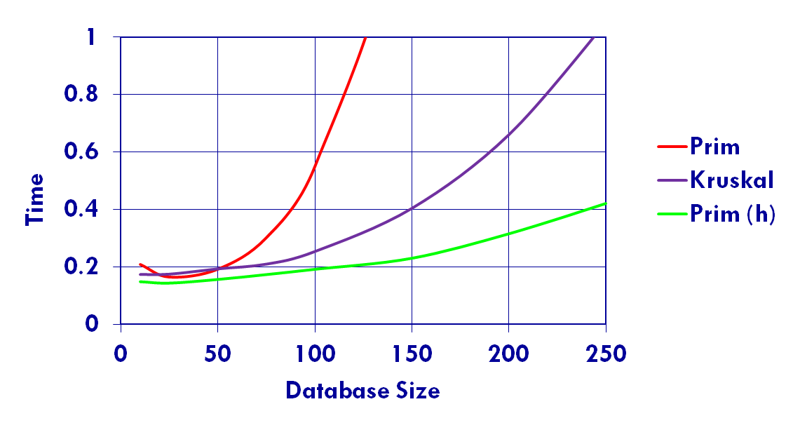
Prime’s Vs Kruskal’s
Time Comparison
Prim with a heap is about twice as fast as Kruskal.
Kruskal is easier to code.
Slide 37

Slide 38
Conclusions
MST → Still works are going on
Boruvka's Algorithm
Inventor of MST
Prim’s algorithm “in parallel”
Huge Number of Applications
Networking
Data mining
Clustering, Classification etc.
Slide 38

